Slide 1
Trainings 10/17/16
Woooo!!!

Slide 2
Strategy And Design
“Champs sounds like fun. How can we go?”

Slide 3
Why Strategy?
The top teams have well defined goals and strategies by the first few days of build, so they know what exactly what they want to accomplish
Teams who strategize well know exactly what to expect - they can accurately predict the most important factors that will determine any team’s success
TL;DR: Strategy-Based Design

Slide 4
The Game
NEW challenge every year (Kickoff)
Understanding the Game Manual
Every game manual includes
Rules
Scoring
Field Layout
KNOW THE MANUAL INSIDE & OUT

Slide 5
MAKING SENSE OF THE GAME | DEVELOPING A STRATEGY
BRAINSTORM
Print out a map (or many maps) of the field (from the game manual) and draw the path of your robot on it as you discuss. This will greatly facilitate visualizing game strategy.
There are no bad ideas: Write down everything
what many consider to be a silly idea may turn out to be the game-winning solution
If you change your strategy, you know why you did or didn’t pick one
Figure out the most efficient way to score points
look at the point breakdown in the game manual, determine efficient strats
What is the overvalued game object (the clinchers)? What will eventually determine which alliance wins the game? e.g. The cans in 2015

Slide 6
DEVELOPING A STRATEGY cont.
Consider Movement throughout the field
Defense?
Open field = High defense/Slow movement
Are there any obstacles in the way?
Scoring: What is the most efficient way to get from point A to point B and score points?
e.g. This year the human player station on the right was next to scoring platform, shortest distance = fastest time to score
Try to Avoid:
Relying on the other teams, a good strategy should be self-fulfilling
Relying on driver maneuvers to evade defense - are there any “protected” zones?

Slide 7
DEVELOPING A STRATEGY cont.
Consider the following:
Chokepoints: is there anything the opponent can do to shut down your strategy?
Techniques that might provide high accuracy in shooting/interacting with game elements
How many points will your strategy score at the highest level?
What is needed to reach this highest level?
Does it allow for a competitive robot that performs below the expected standards?
Autonomous:
Can you acquire game pieces during this time?
Compare value between acquiring game pieces and completing auton
Consider options with lower risk when choosing between two strategies with similar point values

Slide 8
Manipulator Design
List every single task which must be completed (acquire game piece, move across field, score game piece), and then brainstorm potential manipulators to complete each task
Sketch out manipulators for each task on paper
Group together the most feasible ones to make a robot
Look at game strategy and list which manipulators are being used
Consider the motion of each manipulator
Will it fail under heavy load?
Does it have to be overbuilt to work properly? Will it hit other objects?
Does it require variable (slider) or digital motion (on/off)?
Choose the manipulator (or collection of manipulators) that is easiest to make/fortify, and which is the lightest

Slide 9
Build Process
Brainstorm ideas for potential manipulators
Design, build, and test prototypes
Design first iteration of manipulators in CAD
test, build future iterations based on test results (CAD each time)
Send out parts for machining after finalizing design, CAD
Assemble robot, continue to iterate designs where needed
Assemble a second robot, making any necessary changes
Note: time must also be allocated for driver practice and testing code

Slide 10
Step 1: Analyze Game, Determine Strategy
Successful teams have well defined goals and expectations for their robot
These need to be established by the first few days of build
Part A: Scoring Analysis (Scoring methods/requirements, efficiency)
Part B: FIeld Analysis (obstacles/defense, game piece valuation)
Part C: Alliance Analysis (robot roles, counter-strategies/chokepoints, chokehold strategies)
“The best way to get to Einstein is to analyze the game, figure out which three robots would make up the ideal Einstein alliance, and then design, build, iterate, and polish the one that best matches your teams' capabilities.” - Jared Russell, 254 mentor

Slide 11
Step 2: Robot Roles and Criteria
Part A: Consider every single task the robot has to accomplish
ex: acquire game piece, move across field, score game piece
Part B: What criteria/characteristics does our robot have to meet in order to compete at a successful level using our determined strategy?
ex: [X] stacks per match, fast drivetrain
“TIE EVERYTHING BACK INTO THE CHOSEN STRATEGY!!!”
-- Everyone that we should be listening to

Slide 12
Step 3: Manipulator Design
What manipulators would be able to accomplish one/some of the listed tasks, and fit the criteria that we’ve determined?
Brainstorm: DO NOT FILTER IDEAS (yet)
Common manipulators: rollers/intakes, hoppers, elevators, shooters
Are there ways in which we can use one manipulator to accomplish multiple tasks, without sacrificing efficiency/performance?

Slide 13
Step 3.5: Robot Design
Many manipulators make a robot
It’s not one robot, it’s a bunch of manipulators seamlessly put together
Q’s to ask:
Are all the manipulators cohesive? Do they synergize well?
Where are you putting the manipulators on your chassis? Will there be interference?
Can you fit all your manipulators in the weight/size limit?
Do you want or need to combine manipulators?
Are they actually feasible?

Slide 14
Step 4: Prototyping
Helps figure out if/how well a manipulator design will work
Can help determine variable factors
shooter speed/compression, intake geometry
Prototype Plan:
What do you want to prove?
How do you prove it?
Prototypes must be a Minimum Viable Product - DO NOT OVERCOMPLICATE
use existing structures/mechanisms wherever possible

Slide 15
ENOUGH WITH THE BORING STUFF
LET’S GET DOWN TO BUSINESS

Slide 16
2016: Stronghold
The Game
Notable Rules
Low-bar: 16 in high
Max height: 4 ft
Max weight: 120 lbs
Can only control 1 ball at a time
Can’t shoot over defenses

Slide 17
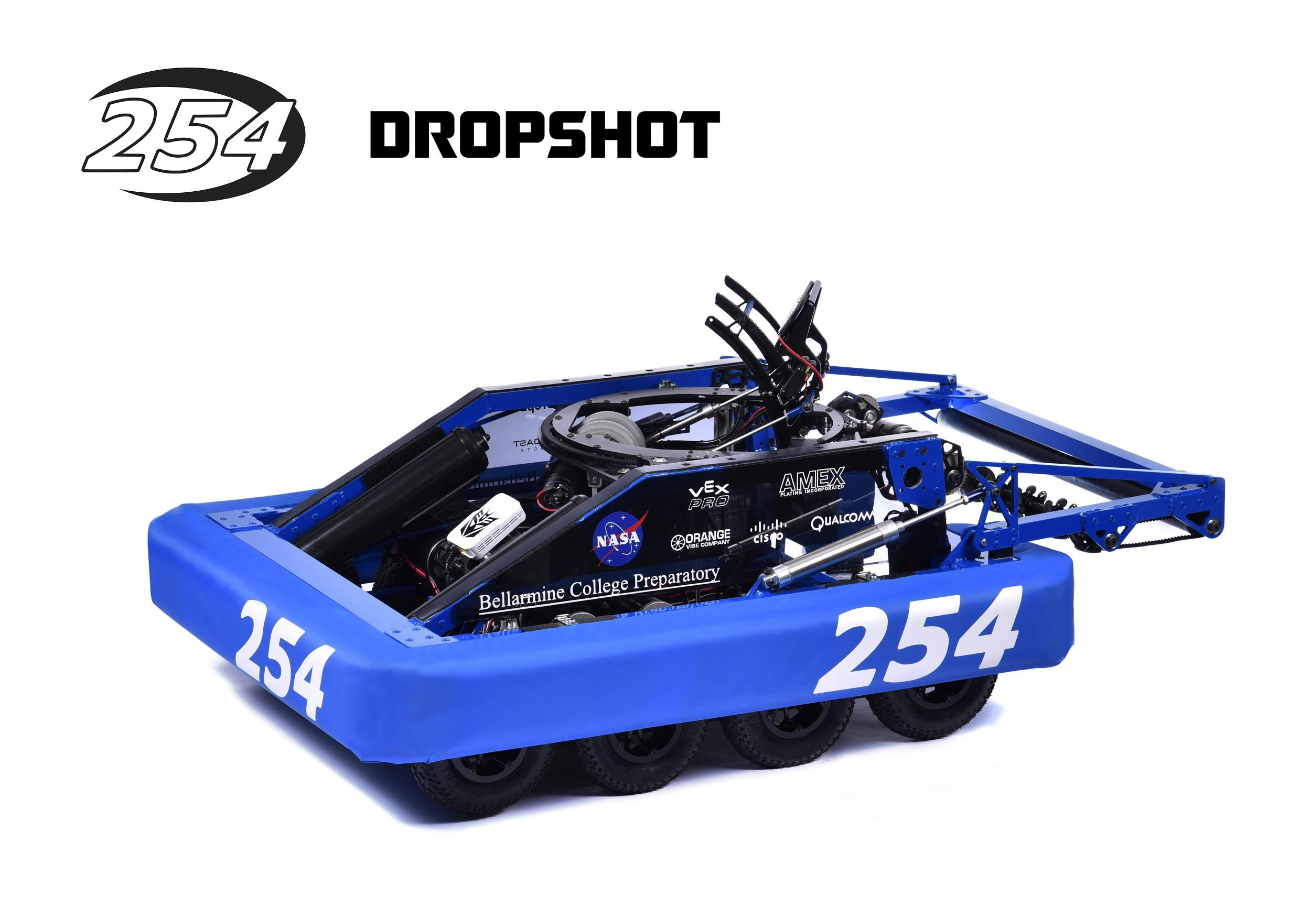
254: The Cheesy Poofs
Vision controlled turret
Always aims at goal
Mecanum intake
Fits under lowbar
Highgoal shooter
Has a climber
8 pneumatic wheels
Newton division finalists
Newton Q100

Slide 18
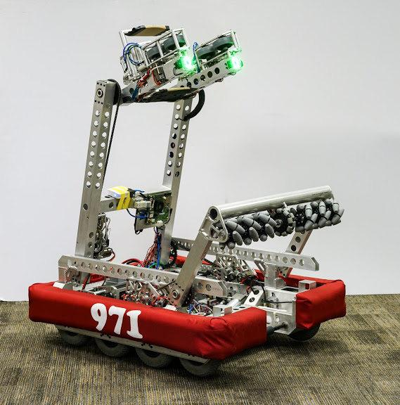
971: Spartan Robotics
Two-part shooter
Reveal
Mecanum intake
Vision controlled
Fingers for feeder
Fits under low-bar
8 pneumatic wheels
Climber
CMP Q90 CMP QF4-8

Slide 19
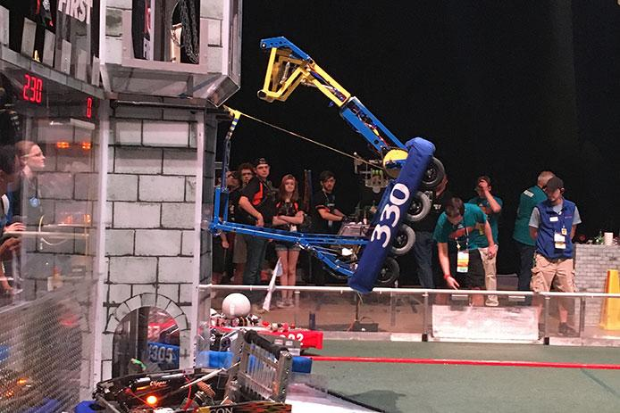
330: Beach Bots
Tall Shooter
Turret on top
Climber
8 pneumatic wheels
Fits under low-bar
Shot from batter
World champs!
QF3M2 Carver

Slide 20
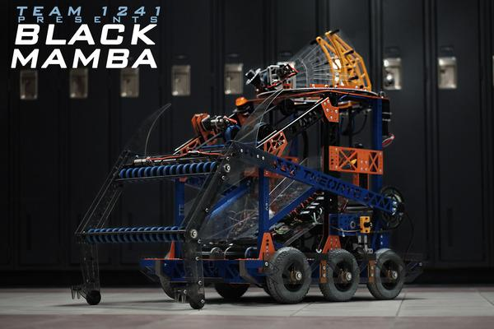
1241: Theory 6
Doesn’t fit under low-bar
Turret on top
Two-part intake
Elevator to turret
6 pneumatic wheels
Vision controlled
FM3 Waterloo

Slide 21
987: The High Rollers
Shooter arm that is on a turret
2 flywheels and a punch to shoot ball
Polychord/angled tape intake
First team to successfully do a 2 ball auton
Fits under lowbar
6 pneumatic wheels
Season recap

Slide 22
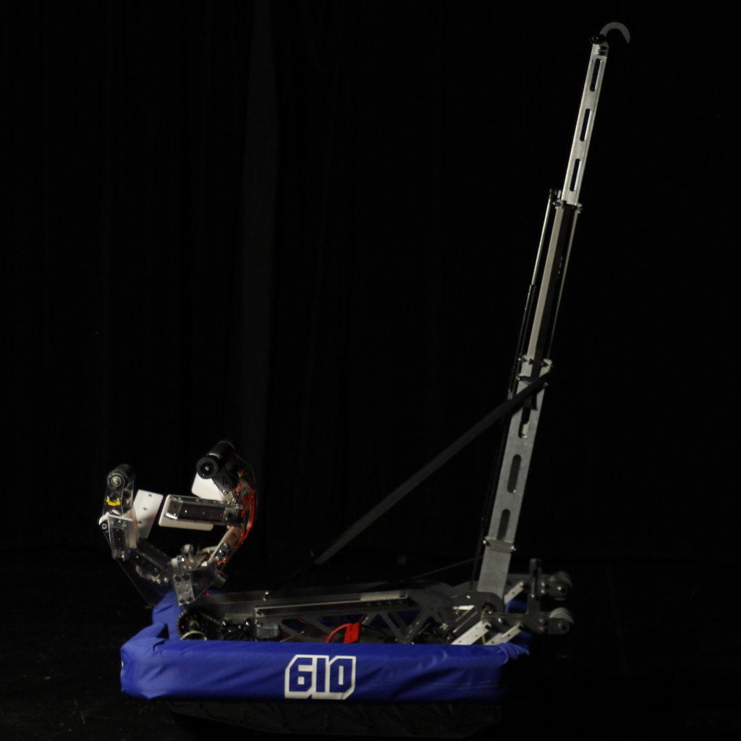
610: Crescent Robotics
Flywheel intake
Climber
Small shooter arm
2 flywheels and punch
Fits under lowbar
SFM2 Waterloo

Slide 23
USEFUL RESOURCES
Chief Delphi: FRC Forum (www.chiefdelphi.com)
Teams’ designs, strategy talks, polls, information - literally everything
FRC Website http://www.firstinspires.org/robotics/frc
FRC Blog: www.firstinspires.org/robotics/frc/blog/
Game Manual/Official Q&A
Official Resources
The Blue Alliance: www.thebluealliance.com
Match videos, results, team info

Slide 24

Manipulators

Slide 25
What is a Manipulator?
Performs a function on a robot
Drives the robot around (drivetrain)
Takes in game pieces (intakes)
Shoots game pieces (shooters)
Places game pieces (placers)
Endgame mechanism (varies)
Many manipulators make a robot
It’s not one robot, it’s a bunch of manipulators seamlessly put together

Slide 26
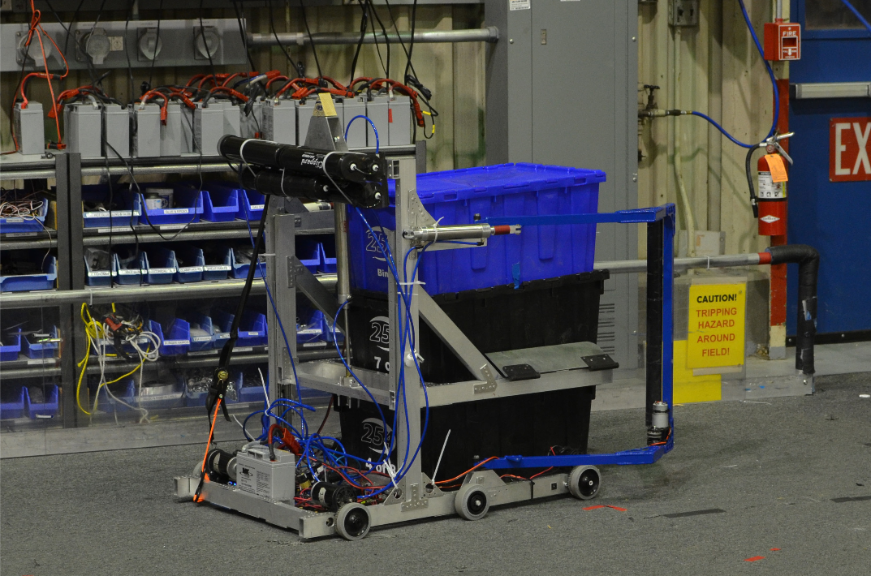
Common Manipulators
FRC uses similar manipulators each year
Drivetrains (99% of robots)
Intakes
Hoppers
Game piece transport
Shooters
Climbers (may have been phased out)
Elevators
While these manipulators may be useful, do not limit yourself to them
the most efficient/effective manipulators may require thinking unconventionally
Ex: Ramps in 2015
254 putting their 2014 robot’s intakes on their 2015 test robot.

Slide 27
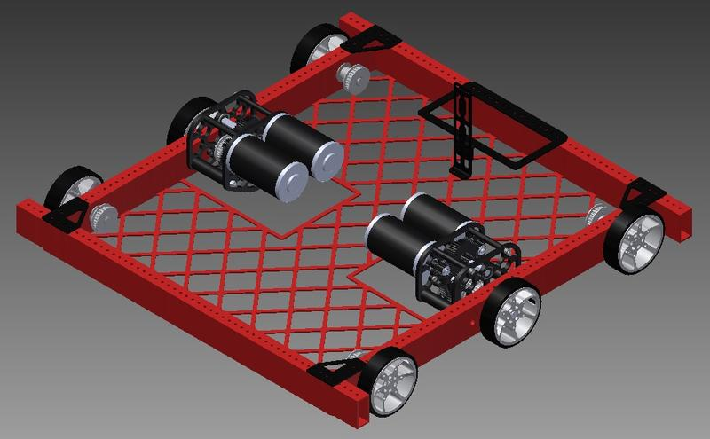
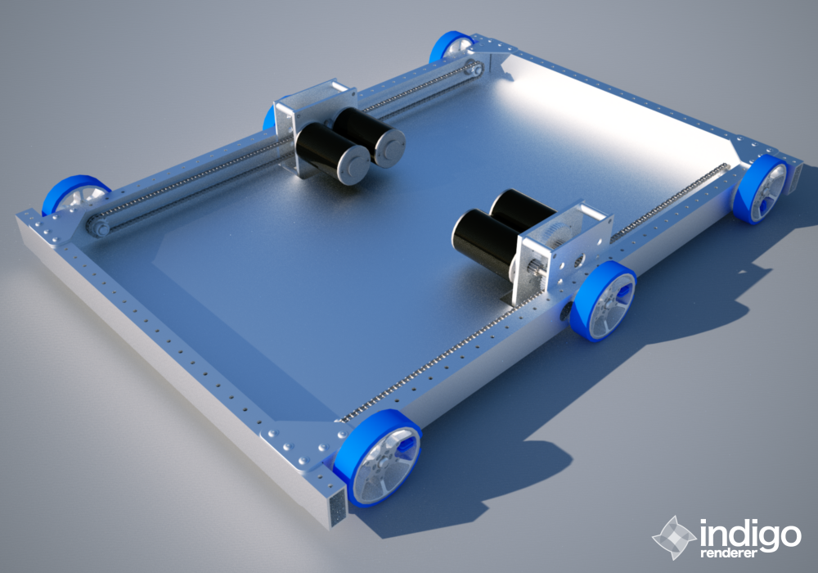
Drivetrain: West Coast Drive
Usually 6 wheels
Dropped Center
Gearbox on the inside
Wheels on the outside
Easy to fix
Easy to make
Left and right sides of the robot are driven independently.
U shaped or rectangular

Slide 28
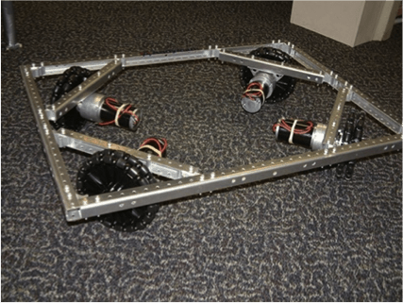
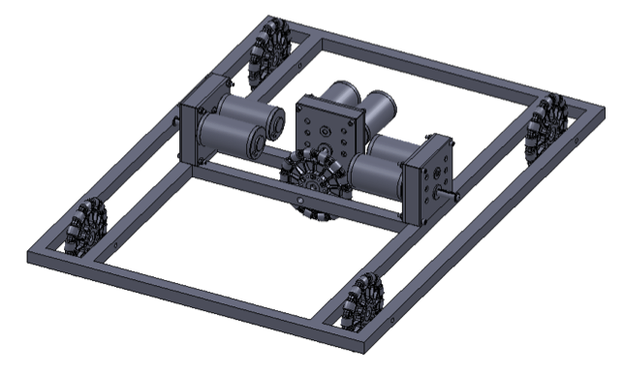
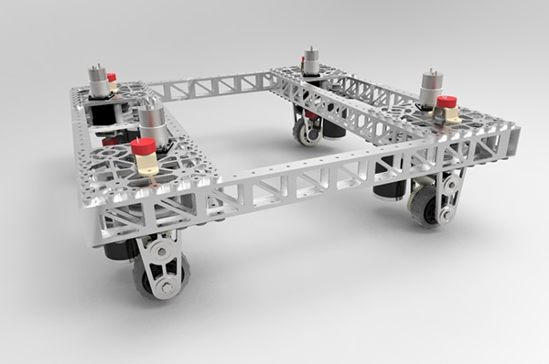
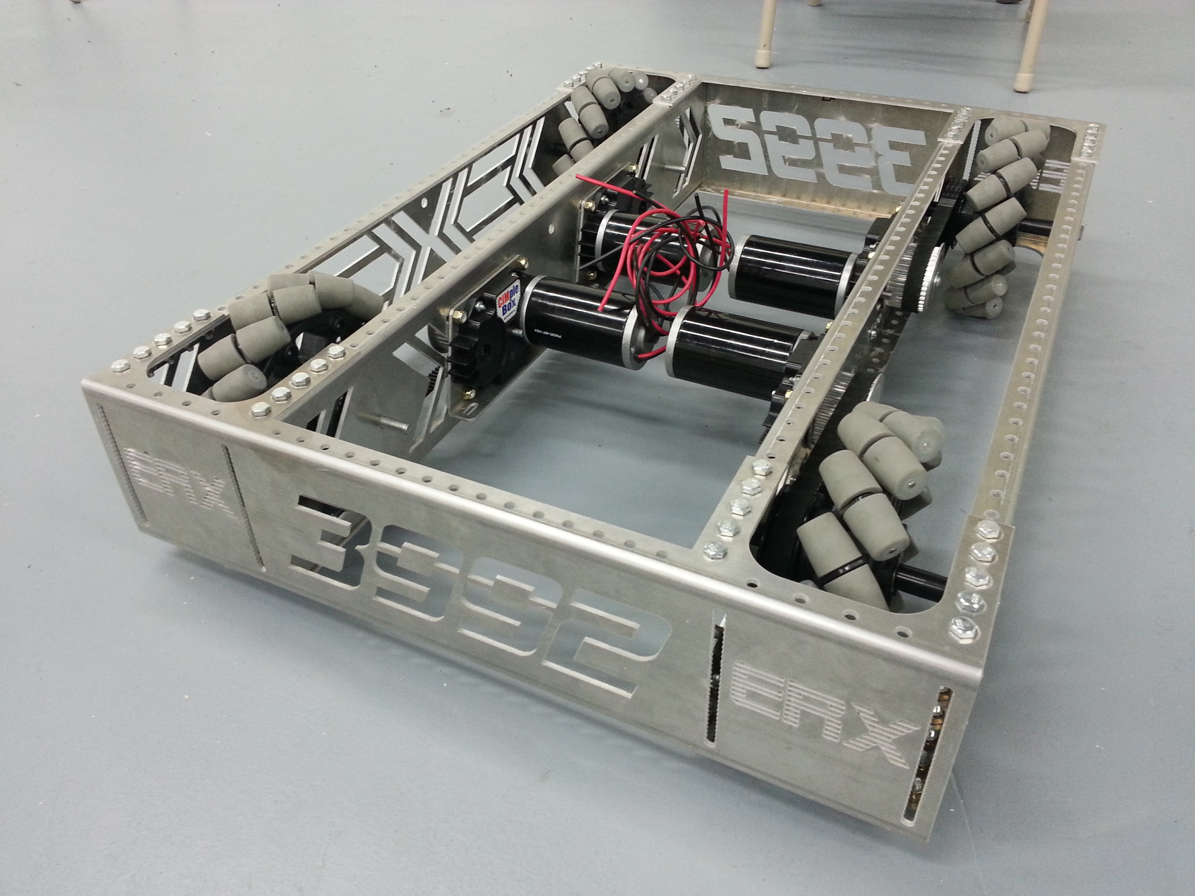
Other Drivetrains
Slide
Swerve
Mechanum
Holonomic

Slide 29
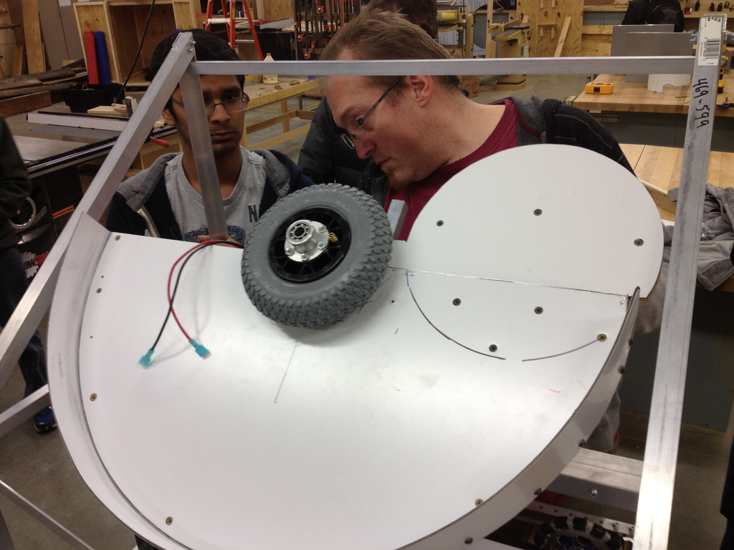
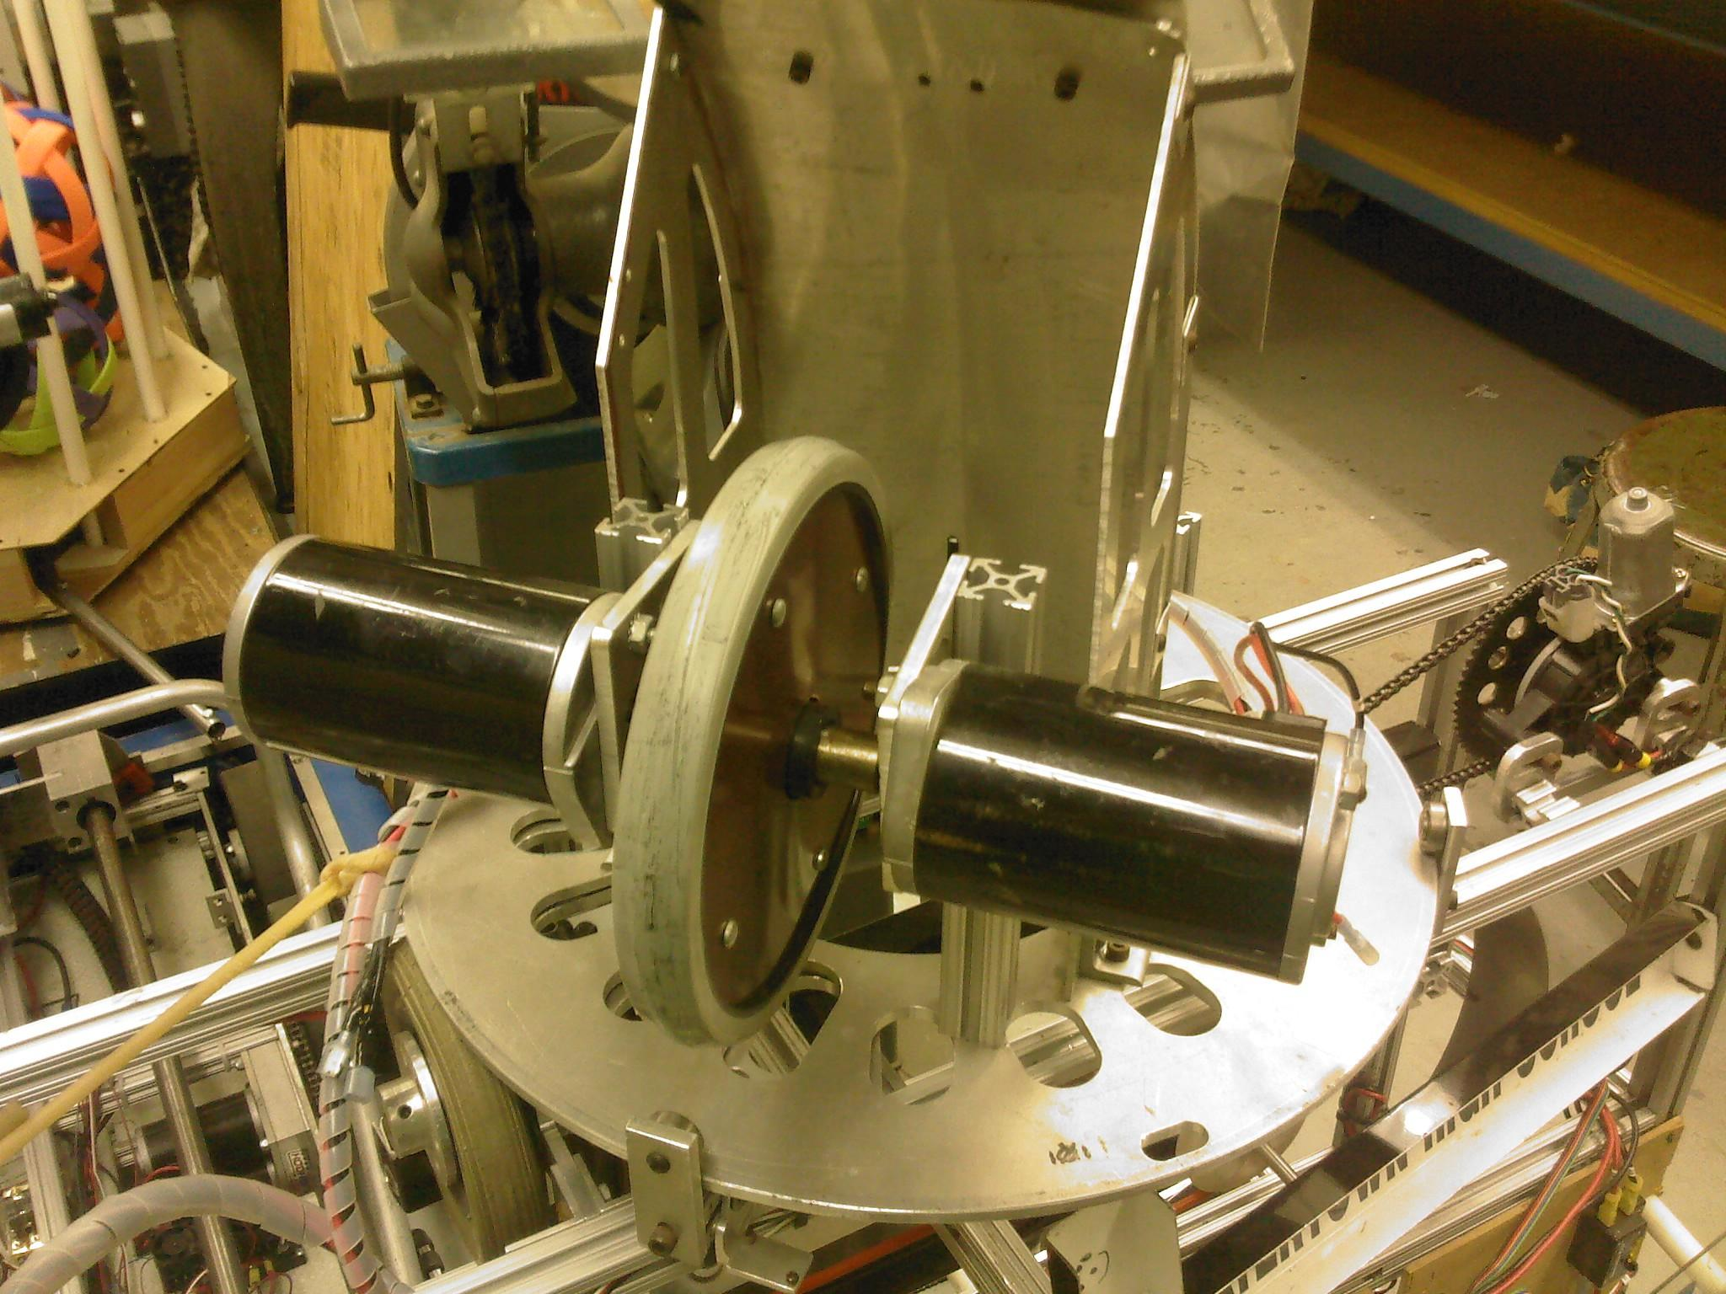
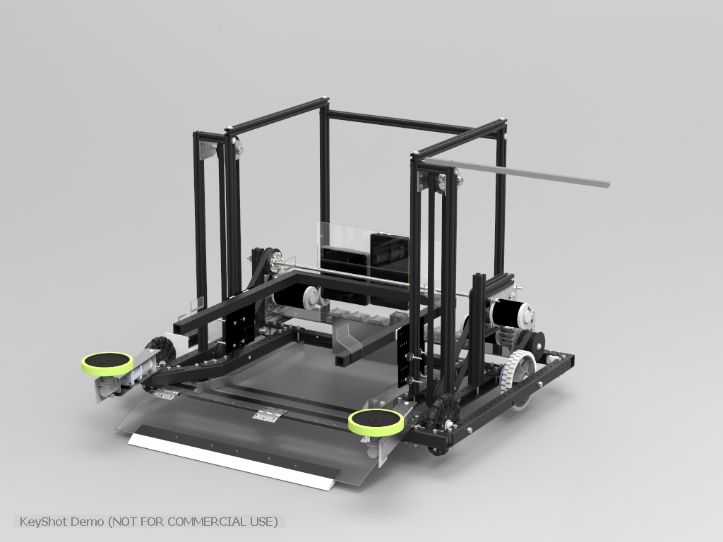
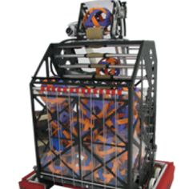
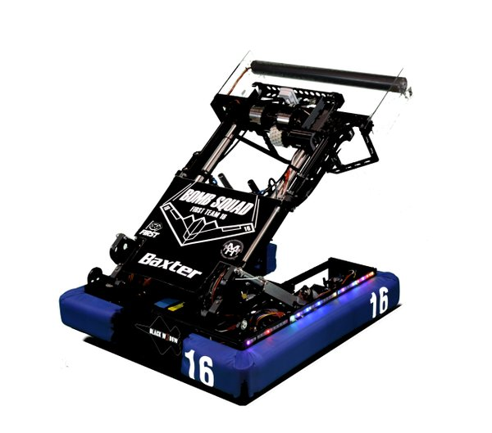
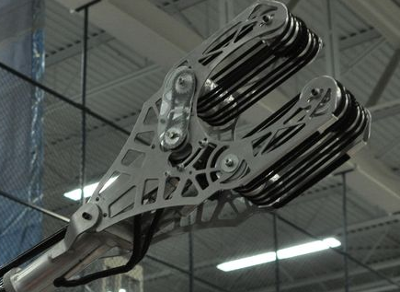
More Manipulator Examples
-Shooters and Intakes

Slide 30
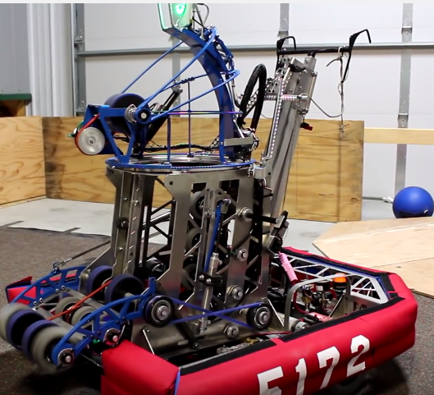
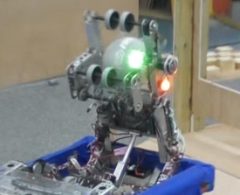
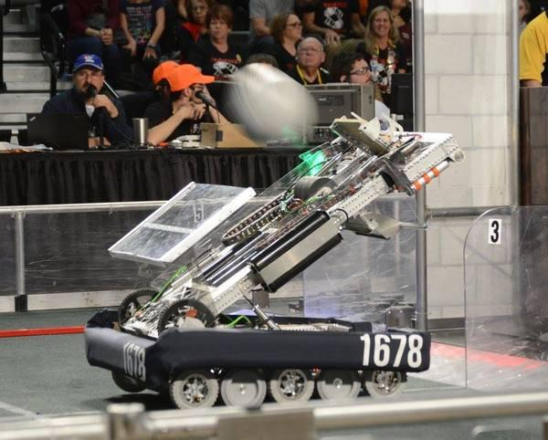
Shooters: Extending Shooter (Tall)
Lifts out from the robot
One or 2 part
Less arc
Requires Big Gearboxes

Slide 31
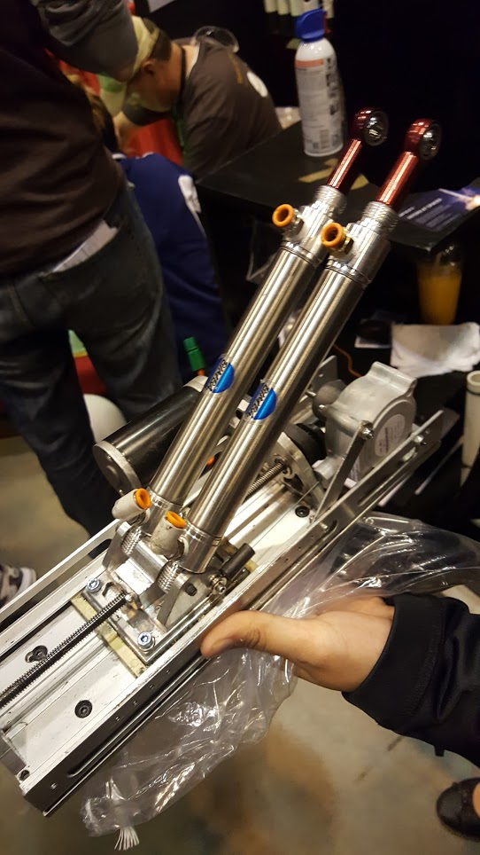
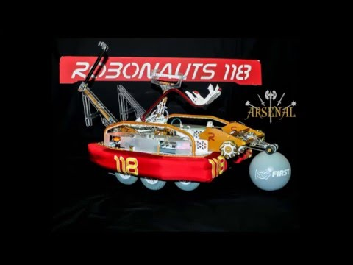
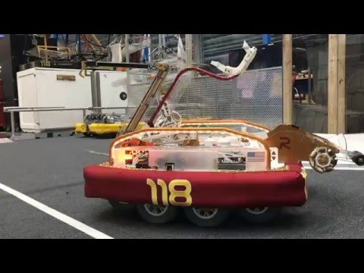
Shooter: Catapult
Lead Screw
String potentiometer
Newton Q100

Slide 32
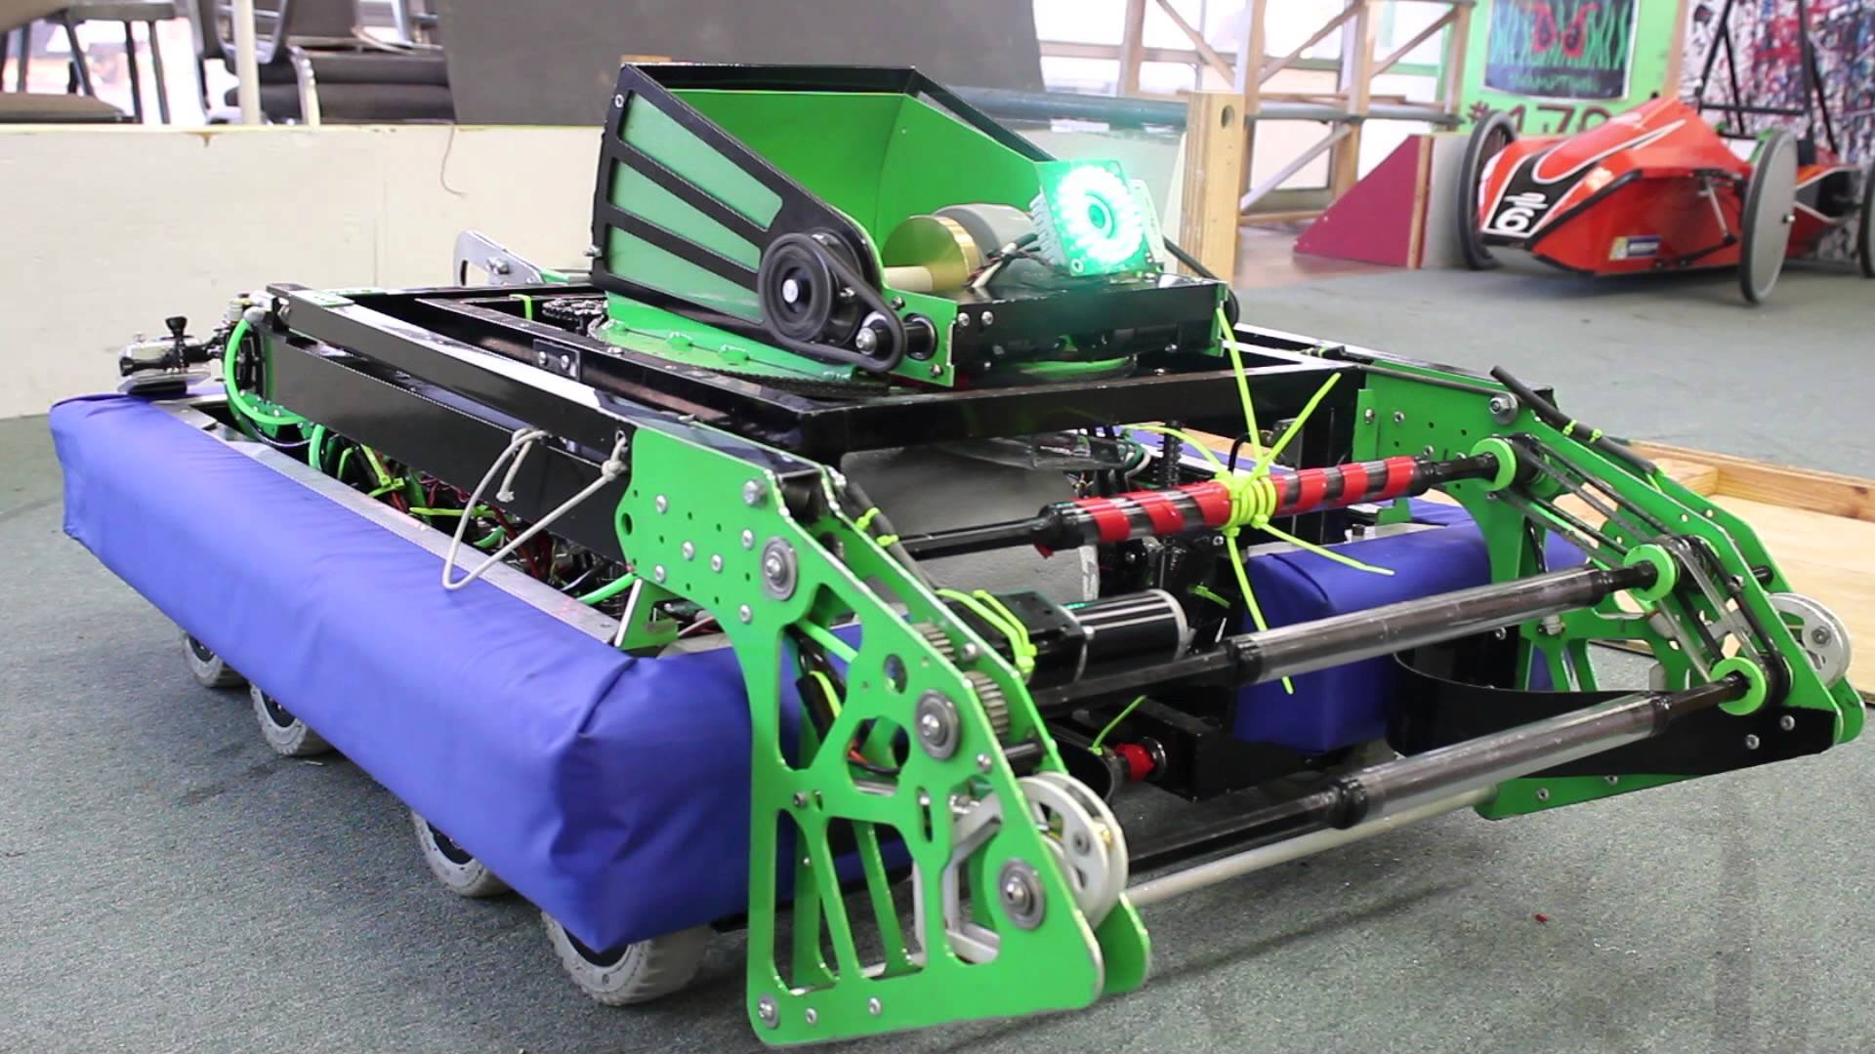
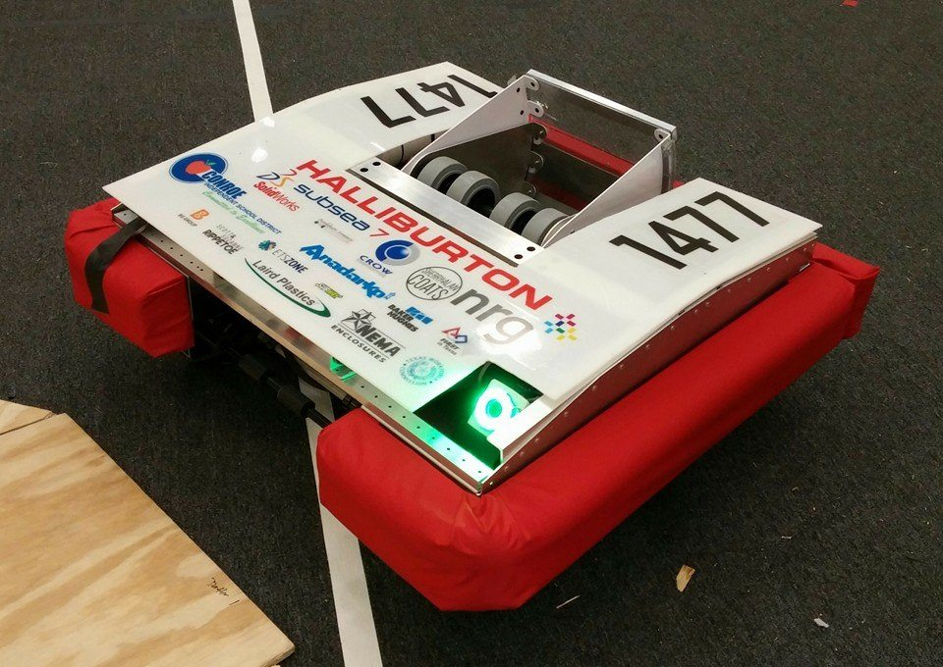
Shooter: Hooded
Turret Variant
Adjustable hood
Lots of arc
Can be Small
Rising variant

Slide 33
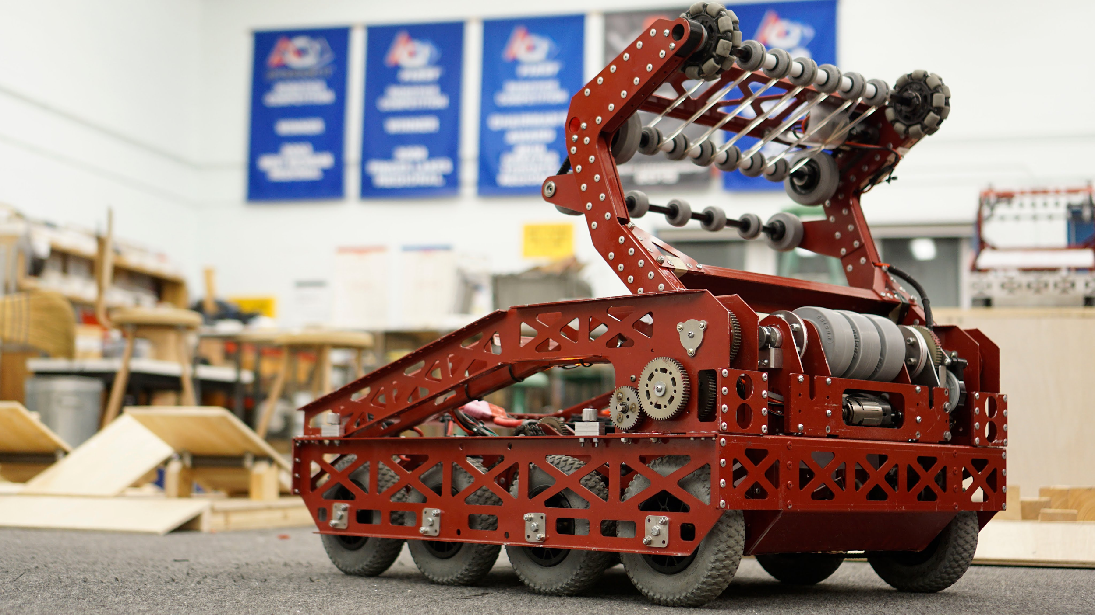
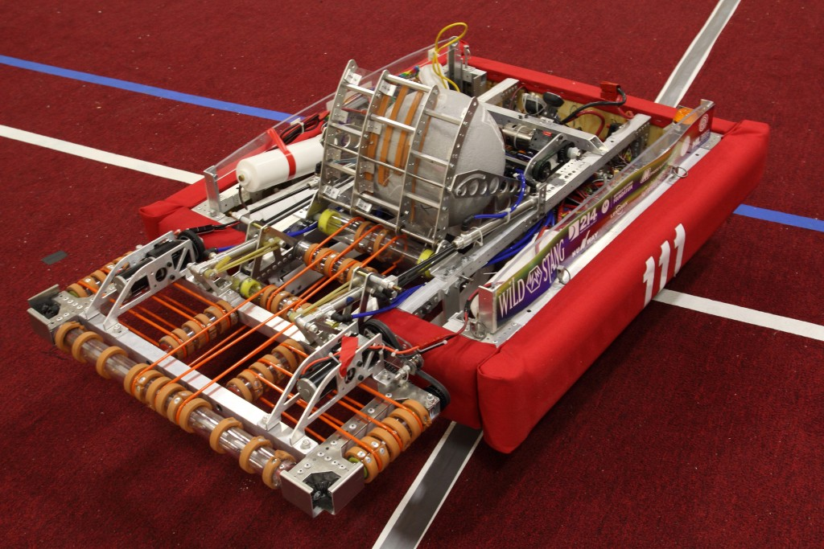
Intakes
Mechanum Intake
Angled tape
Polycord intake
Rising intake

Slide 34
Manipulator Design Introduction
Important to know the goals and basic rules of the game
Try to combine x number of functions into <x number of manipulators
But don’t sacrifice functionality for marginal weight decreases!
2016 Chival/Intake
Brainstorm with groups, more ideas
Think outside the box
Examples of this vary from year to year
Game-breakers fall into this category
Be accepting of everyone’s input
You aren’t always right

Slide 35
Brainstorming
What is the goal of the game? What seems to be the most important?
What kind of manipulators do you think you’ll need to do all the tasks?
Are all the manipulators cohesive? Do they synergize well?
Where are you putting the manipulators on your chassis?
Can you fit all your manipulators in the weight/size limit?
Do you want or need to combine manipulators?
Are they actually feasible?
No flying robots pls (this is actually illegal)

Slide 36
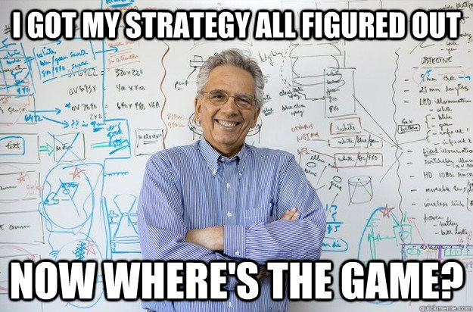

Slide 37
2016: Stronghold
The Game
Split into groups of 5
Come up with a strategy and a design for a shooter
We will continue this tomorrow, so save your work!!!

